Slide 1
CHAPTER 8
Service Innovation and Design

Slide 2
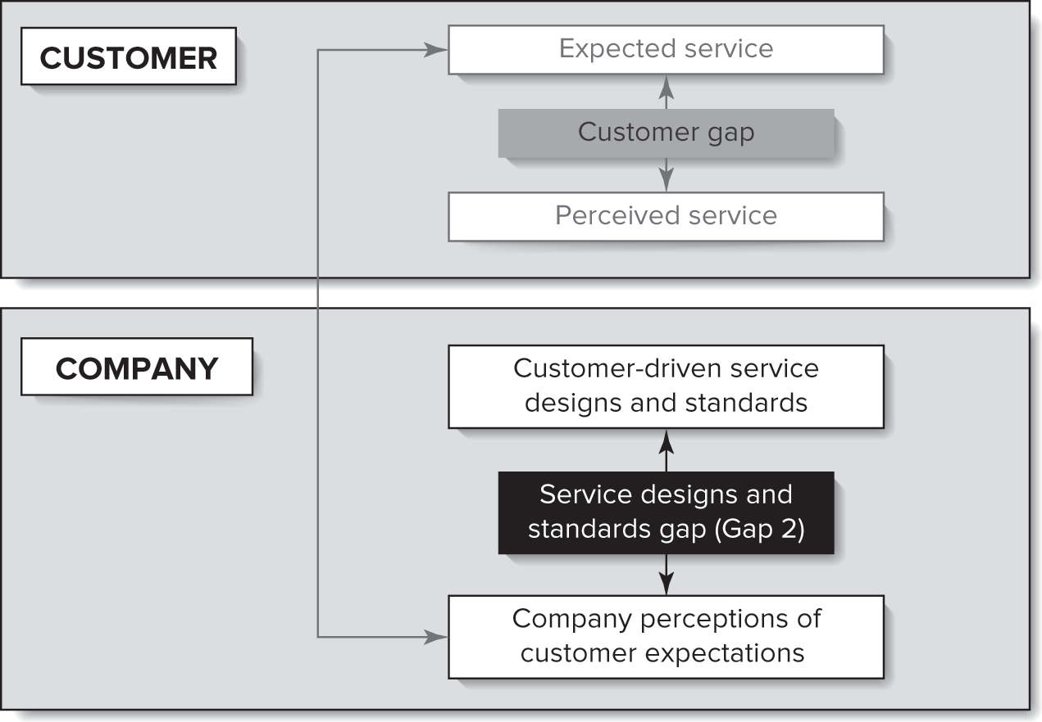
Service Design and Standards Gap

Slide 3
Chapter Objectives
Describe the challenges inherent to service innovation and design.
Present an array of different types of service innovations, including service offering innovation, innovating around customer roles, and innovation through service solutions.
Discuss the importance of engaging customers and employees and employing service design thinking.
Present the stages and unique elements of the service innovation and development process.
Demonstrate the value of service blueprinting as a technique for service innovation and design.

Slide 4
Define Service Innovation
New or improved service concept that satisfies customer’s unmet needs

Slide 5
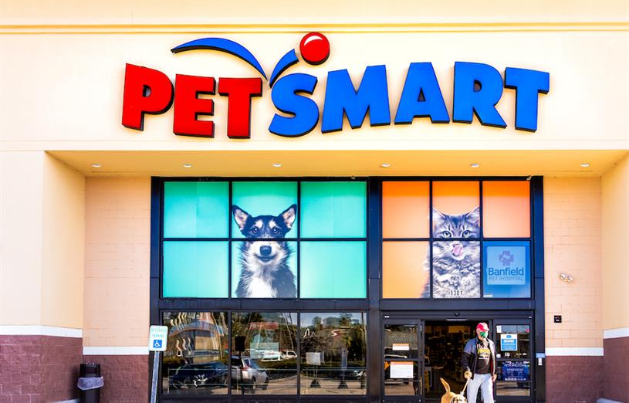
Why are some businesses more successful at introducing services than others?
Example: PetSmart moving from a warehouse of products to now focusing on pet services.

Slide 6
Characteristics of Successful Innovations
Product/ service characteristics: meeting customer needs, advantage over competing products, technological sophistication
Strategy characteristics: dedicated human resources to support, dedicated research and development
Process characteristics: marketing, predevelopment, technological, and launch proficiencies
Marketplace characteristics: market potential

Slide 7
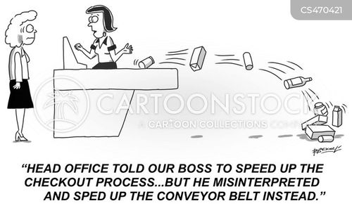
To sell a service you must describe it, but there are risks when describing a service
Oversimplification
Incompleteness
Subjectivity
Biased Interpretation
Notes:
Oversimplification: like describing the space shuttle as something that flies. Words are inadequate to describe a complex service system.
Incompleteness: when describing services, people tend to omit details they are not familiar with.
Subjectivity: anyone describing a service will be biased by their own experiences and exposure to the service. We all have our own opinions even in the same service!
Biased Interpretation: no two people will describe a service (or their experience) in the exact same way and how others interpret what is said will also vary.

Slide 8
Considerations for Service Innovation
Cocreative
Sequencing
Evidencing
Holistic
User-centered
Involve customers and employees
Employee Service Design Thinking and Techniques
Five principles of service design thinking
Notes:
Employees are on the service, customers co-create the service
User-centered: services should be experienced and designed through the customer’s eyes.
Cocreative: all stakeholders should be included in the service design process.
Sequencing: a service should be visualized as a sequence of interrelated actions.
Evidencing: intangible services should be visualized in terms of physical artifacts.
Holistic: the entire environment of a service should be considered.

Slide 9
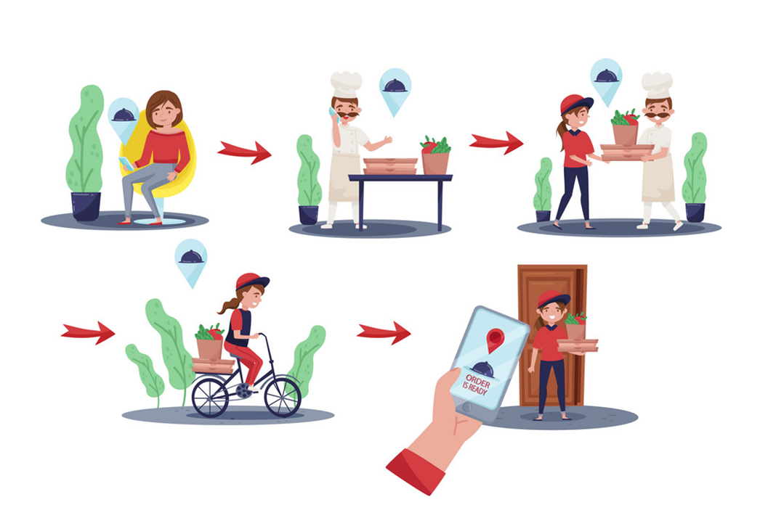
Example: Design a Food Delivery Service
Cocreative
Sequencing
Evidencing
Holistic
User-centered
Customers
Employees (including delivery partners)
Partner restaurants
Primarily students
Customer needs – what would this include (e.g., price)?
External environment
Regulators
Market potential
Web/ mobile application (what features are important here?)

Slide 10
Types of Service Innovations
We will review several types of service innovations.

Slide 11


Service Offering Innovation
Major or Radical Innovations
New services for markets that have not yet been defined.
Example: Amazon’s introduction of same-day and two-day delivery.
Often these major innovations create brand new markets.

Slide 12

Service Offering Innovation
New Services for the Currently Served Market
Attempts to offer existing customers of the organization a service not previously available from the company (though it may be available from other companies).
Sometimes this is a stand-alone service like PetSmart Hotels and other times this is an enhancement like health club offering nutrition classes.

Slide 13
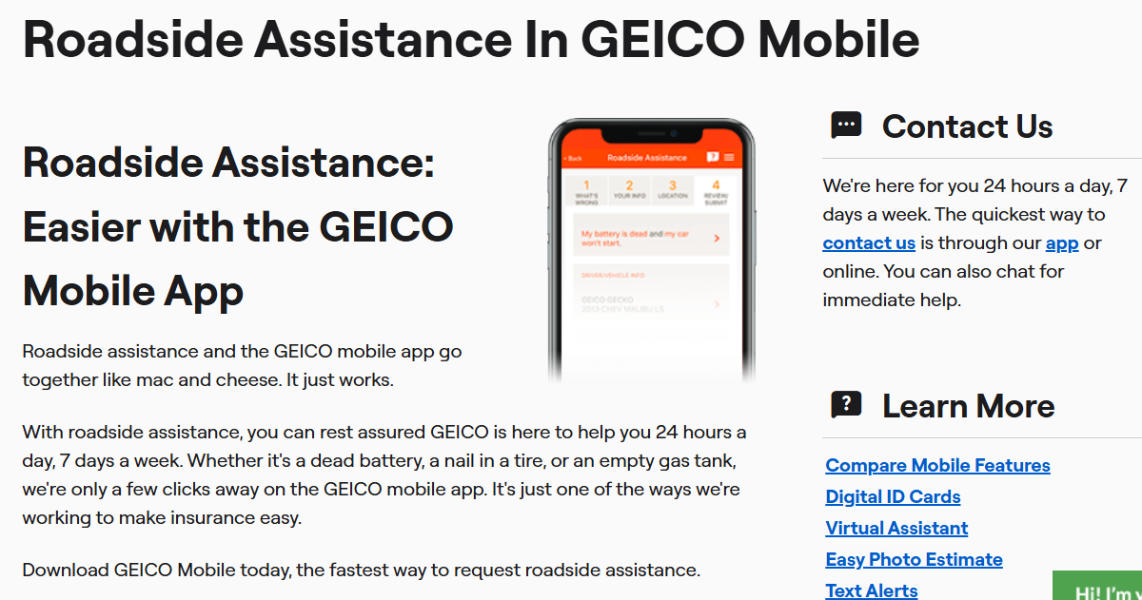
Service Offering Innovation
New Services for the Currently Served Market
Free wireless broadband by Starbucks
Package pickup and return counters inside Walgreens
Capital One moving into Capital One Cafe

Slide 14
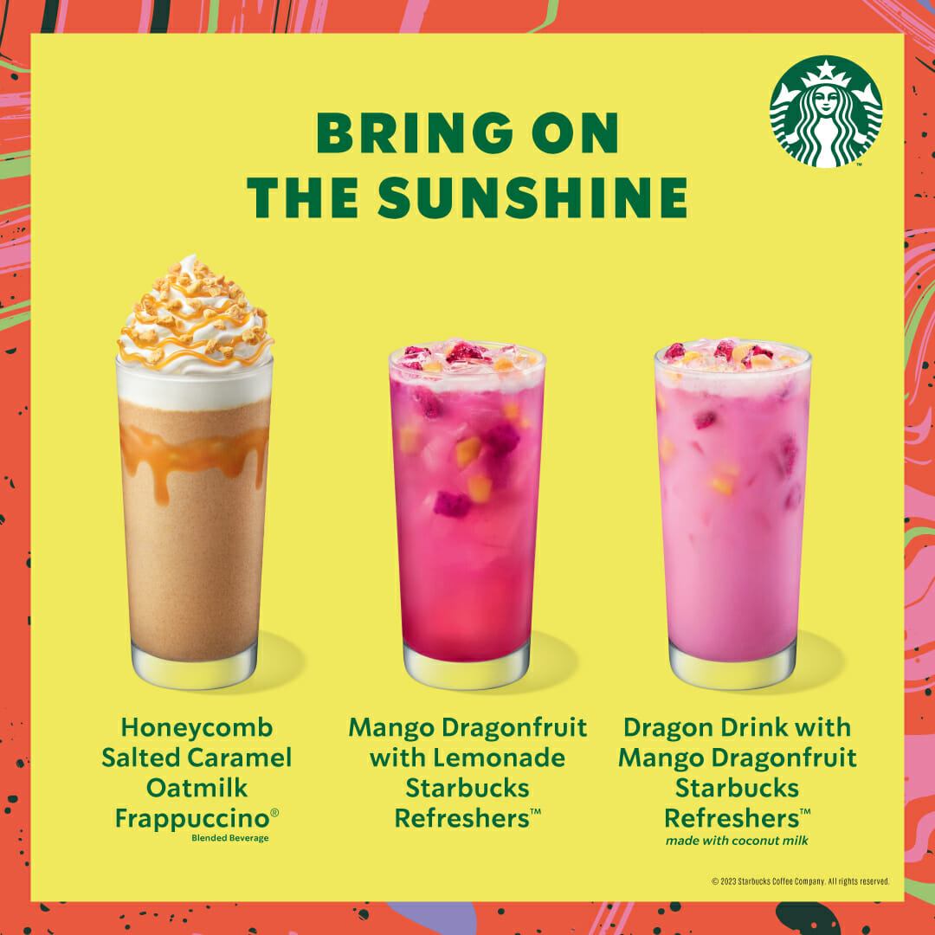

Service Offering Innovation
Service-line Extensions
Augmentations of the existing service line.
  Example: new menu items in restaurants; new routes on flights

Slide 15

Service Offering Innovation
Service Improvements
The most common type of service innovation.
Changes in features of service already offered might involve faster execution of an existing service process.
  Example: extended operating hours

Slide 16

Service Offering Innovation
Style Changes
The most modest service innovation.
Highly visible and can have significant effects on customer perceptions, emotions, and attitudes.
  Example: changing the color of a logo or redesigning a website.

Slide 17
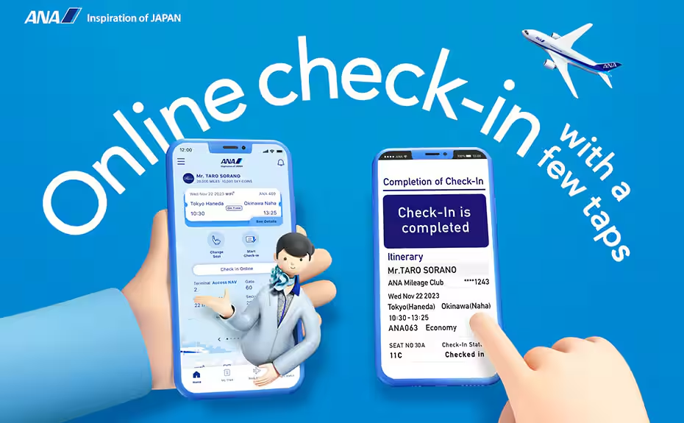
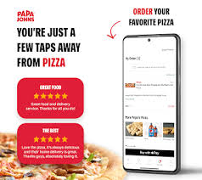
Internet-enabled Service Innovation
Benefiting customers through internet
Separate production and consumption
Centrally produced
Consistent due to standardized processes
Scalable
Notes:
“Nike is among the first to use the Web to deliver this service.… Nike’s new site provides consumers the opportunity to build their own Nike product (primarily shoes, but also a few other items in the baseball/softball and team categories).

Slide 18
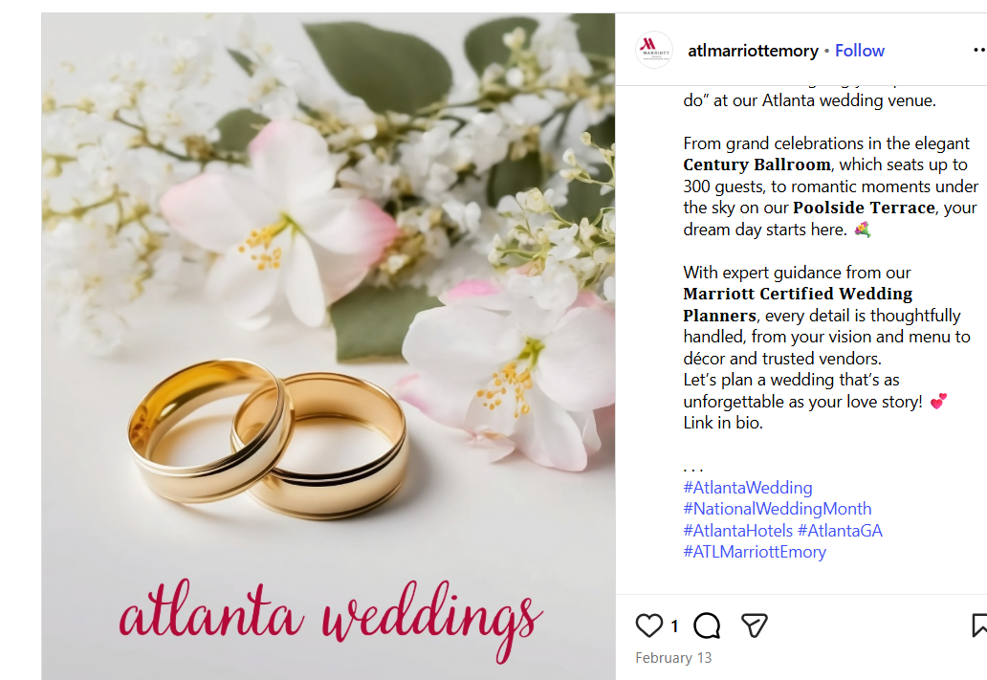
People-enabled innovation
Delivered primarily through human interactions
Simultaneous production and consumption
Inconsistency
Notes:
Gateway, Inc. (NYSE: GTW) today begins offering technology installation services into homes across the U.S. with the Gateway House Call program ... With 296 stores acting as service hubs in virtually all major U.S. metropolitan areas, Gateway dispatches highly skilled technicians into customers’ homes to set up their PCs

Slide 19
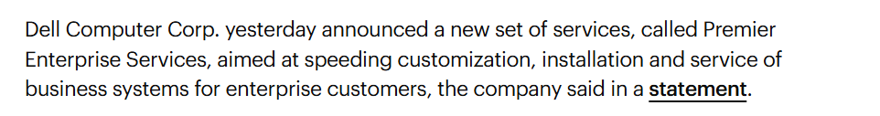
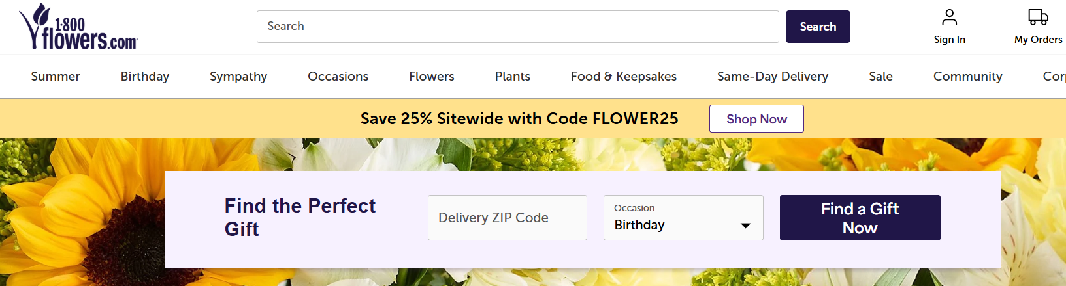
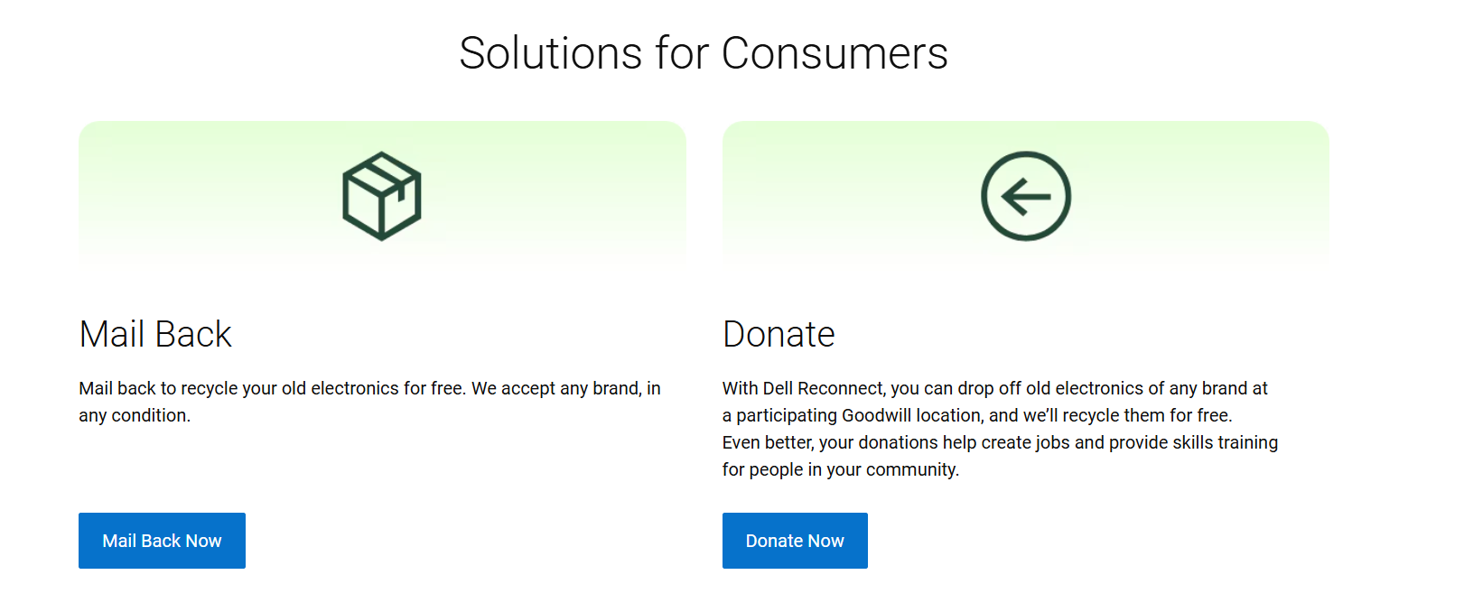
B2B and B2C Service innovations

Slide 20
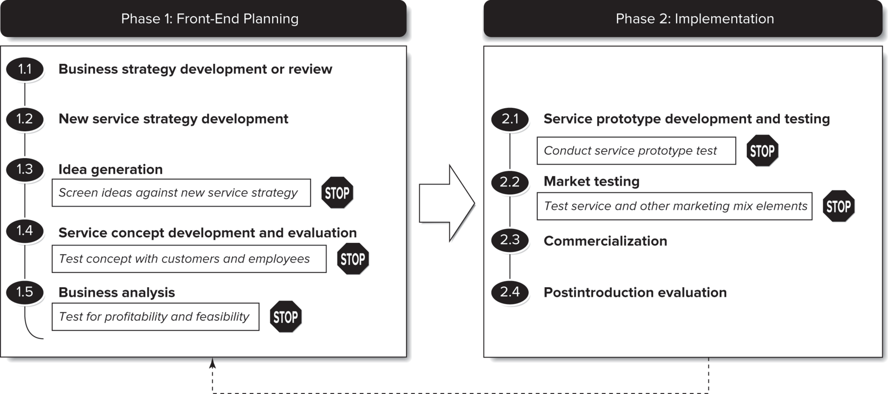
Service Innovation and Development Process
Requirements that a new service must meet before moving to the next stage.
Notes:
The stop signs represent checkpoints that separate the critical stages of the development process. The checkpoints specify requirements that a new service must meet before it can proceed to the next stage of development.
Implementation is different for services.
New service or product development is not always a linear process.

Slide 21
Phase 1: Front-End Planning
Five-step process

Slide 22
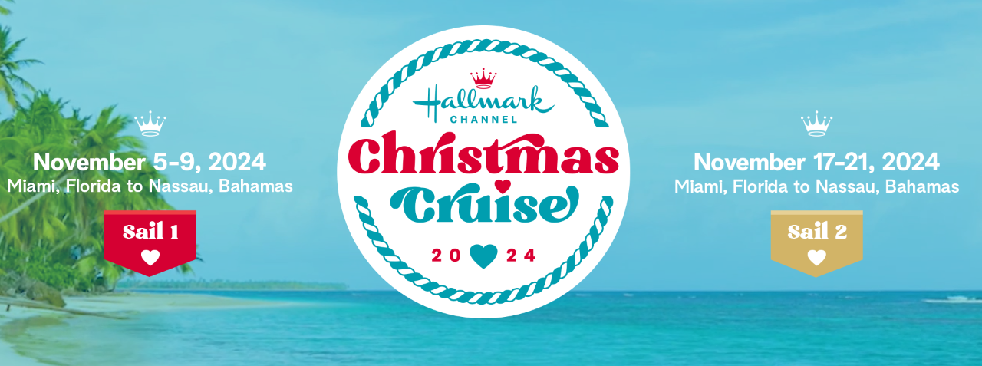
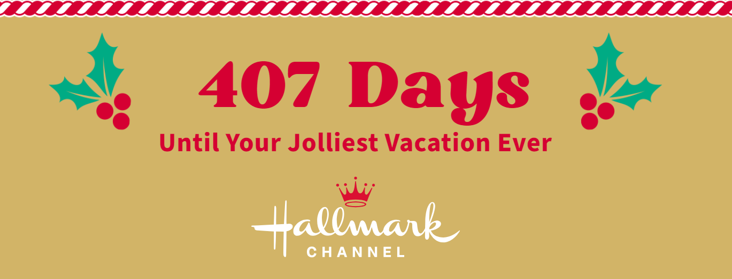
Business Strategy Development or Review
The new service strategy and specific new service ideas must fit within the larger strategic mission and vision of the organization.
  What is the mission of the company? (You can usually find this in the tag-line).
  How does this new service fit that mission?

Slide 23
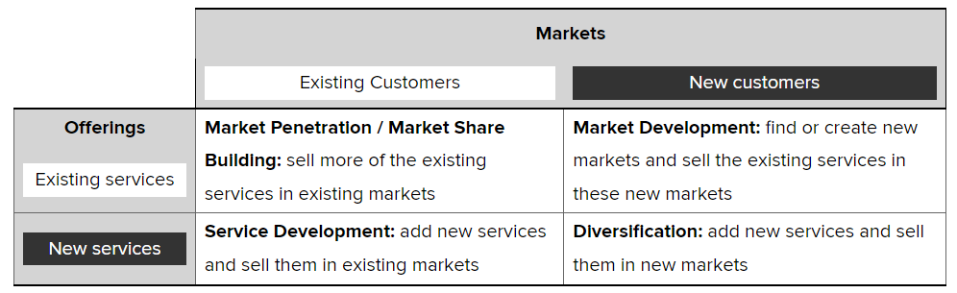
New Service Strategy Development
This framework allows and organization to identify growth opportunities and can be helpful as a catalyst for creative ideas.

Slide 24
Idea Generation
Generate new ideas that can be evaluated in light of the new service strategy screening criteria described in the preceding steps.
Can include collaboration with customers, vendors, even competition.
Observing customers and how they use the firm’s services and products can also elicit creative ideas (empathic design).
There must be some established mechanism for ensuring an ongoing stream of new service possibilities.

Slide 25
Service Concept Development and Evaluation
Drawing pictures and describing an intangible service in concrete terms are difficult, especially if it is co-created in real time with customers (ex. hairdresser).
The phase takes multiple versions until reaching a defined concept.
After clear definition of the concept, a description should be produced that represents its specific characteristics.
  This is called a service design document.
Then, you want to determine initial customer and employee responses to the concept.

Slide 26
Business Analysis
Assuming the new service concept is favorably evaluated:
  Estimate its economic feasibility
  Estimate its potential profit implications
  Develop a demand analysis (who will want the service?)
  Predict revenue projections (how much money will you make?) and how much will it cost
  Assess operational feasibility (what changes will be needed to make this happen? Can your current facility/employees accommodate this new service?)

Slide 27
Phase 1I: Implementation
Four-step process

Slide 28
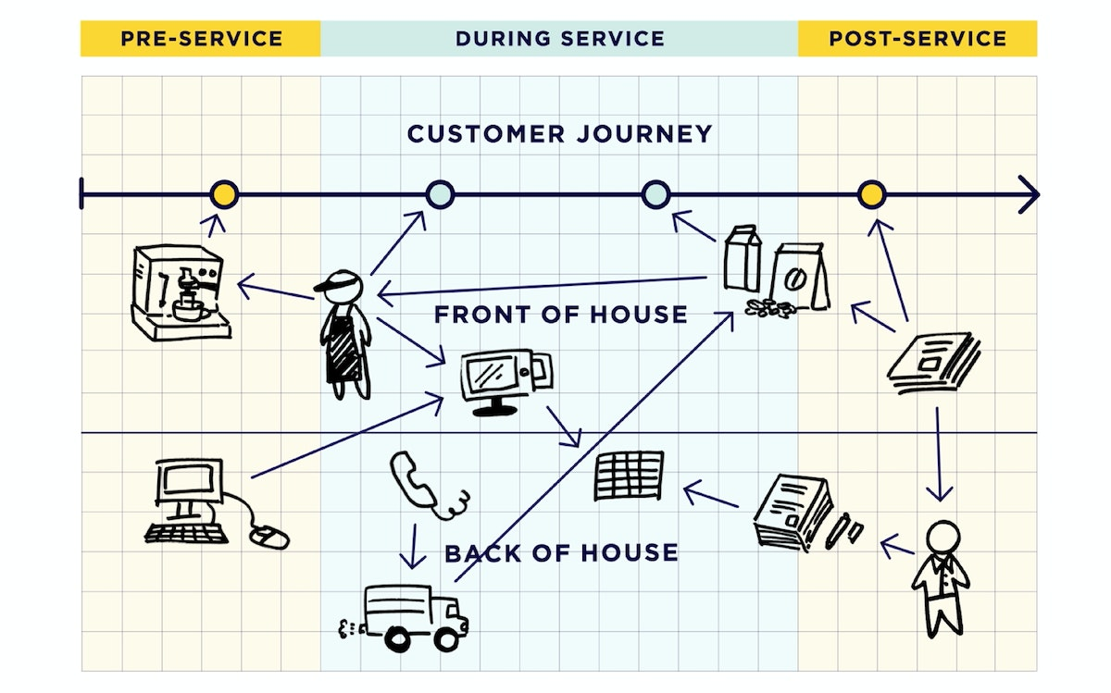
Service Prototype Development and Testing
This step should involve all those who have a stake in the new service: customers, employees, representatives, operations, etc.
This phase produces a detailed blueprint of the customer experience and the implementation plan for the service.
IDEO prototype for Crowne Plaza lobby

Slide 29
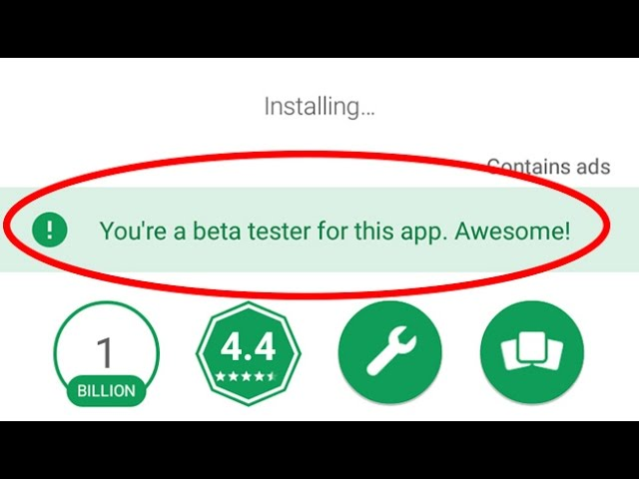
Market Testing
Test the response against the marketing mix variables and distributing system.
Trying to identify an isolated market to test can be challenging so sometimes companies use their employees.
Continual pilot testing is critical!

Slide 30
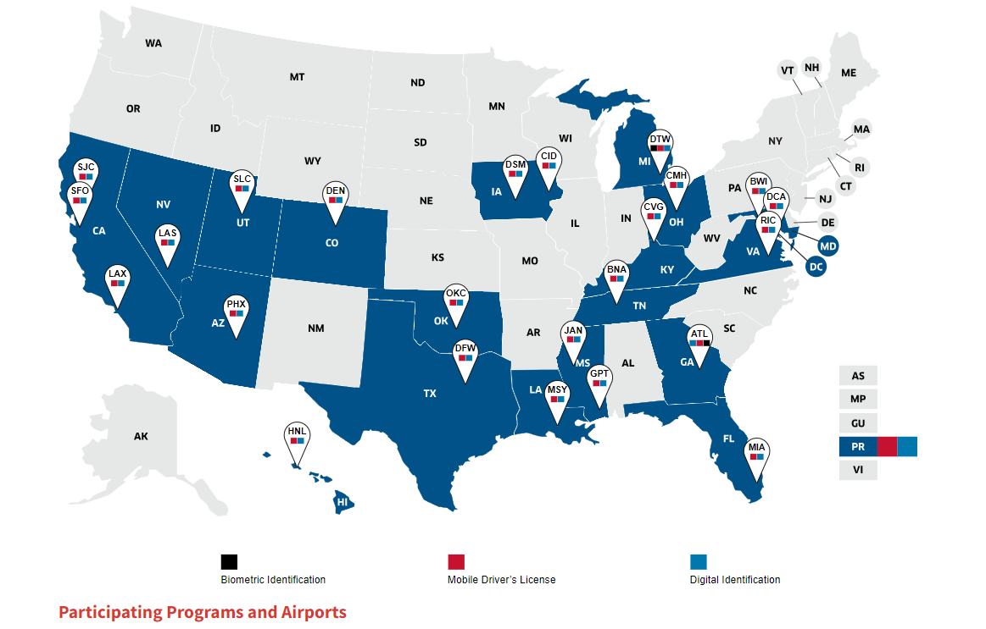
Commercialization
The service is live! This stage has two primary objectives:
  To build and maintain acceptance of the new service among large number of the service delivery personnel who are responsible day-to-day for service quality.
  To monitor all aspects of the service during introduction and through the complete service cycle.

Slide 31
Postintroduction Evaluation
Information gathered during commercialization can be reviewed and refinements are made to the delivery process, staffing, or marketing mix variable.
Formalizing a review process is important for this stage to be effective.
Utilizing the customer’s viewpoint is also critical for this stage to be effective.

Slide 32
Service Blueprinting
A technique for service innovation and design.

Slide 33
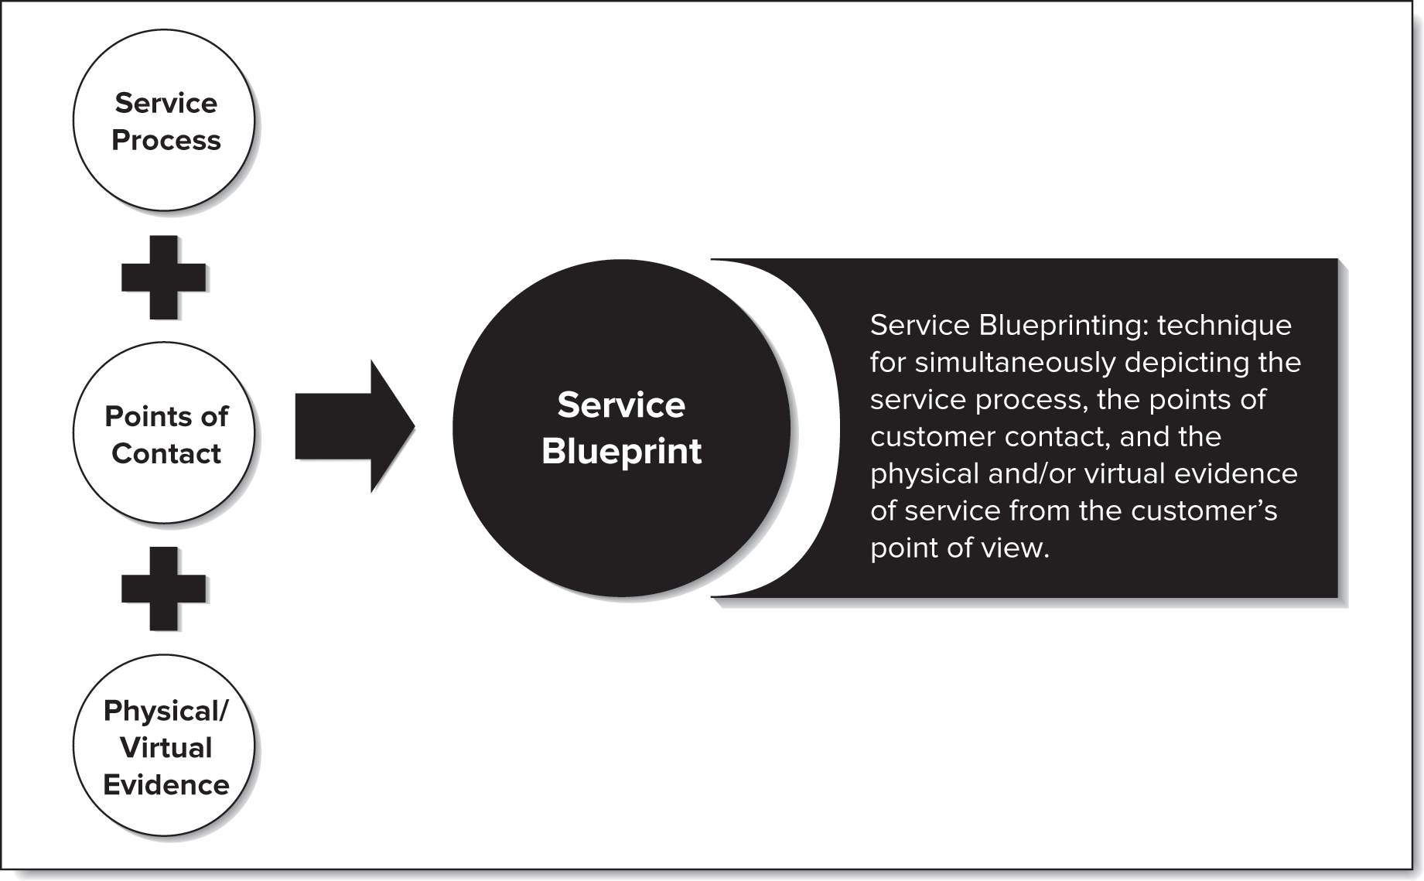
What is a Service Blueprinting?
A service blueprint is a picture or a map that portrays the customer experience and the service system, so that the different people involved in providing the service can understand it objectively.
A service blueprint visually displays the service, breaks it down into its logical components, and depicts the steps or tasks in the process.

Slide 34
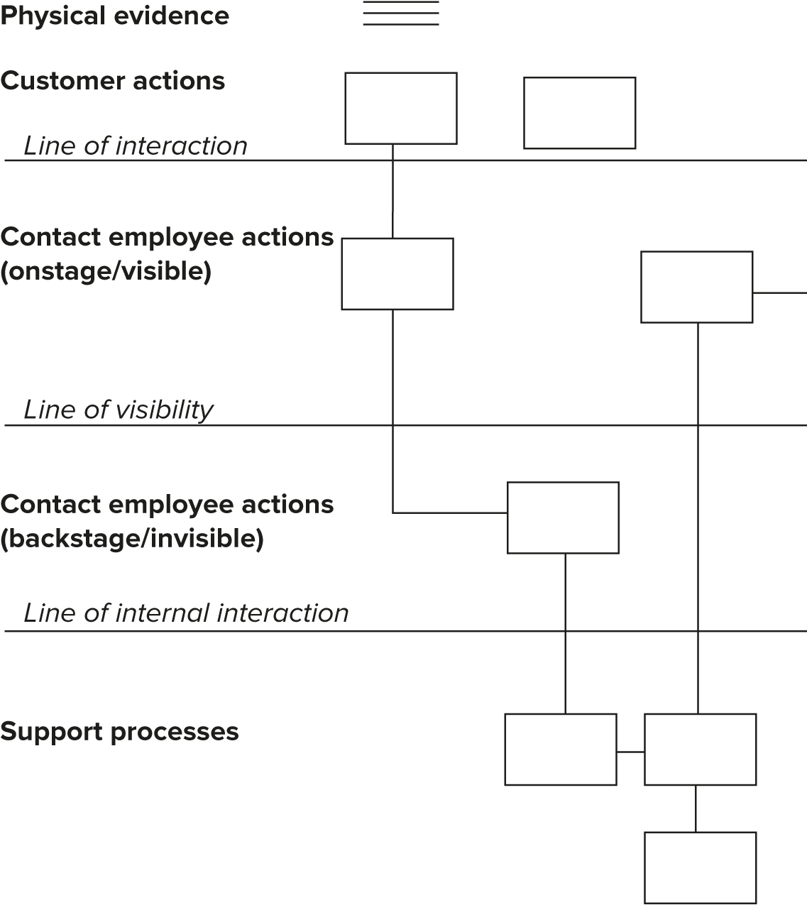
Blueprinting Components
Action Areas:
Customer actions
Onstage/ visible contact employee actions
Backstage/ invisible contact employee actions
Support processes
Physical evidence
Points of Interactions:
Line of interaction
Line of visibility
Line of internal interaction

Slide 35
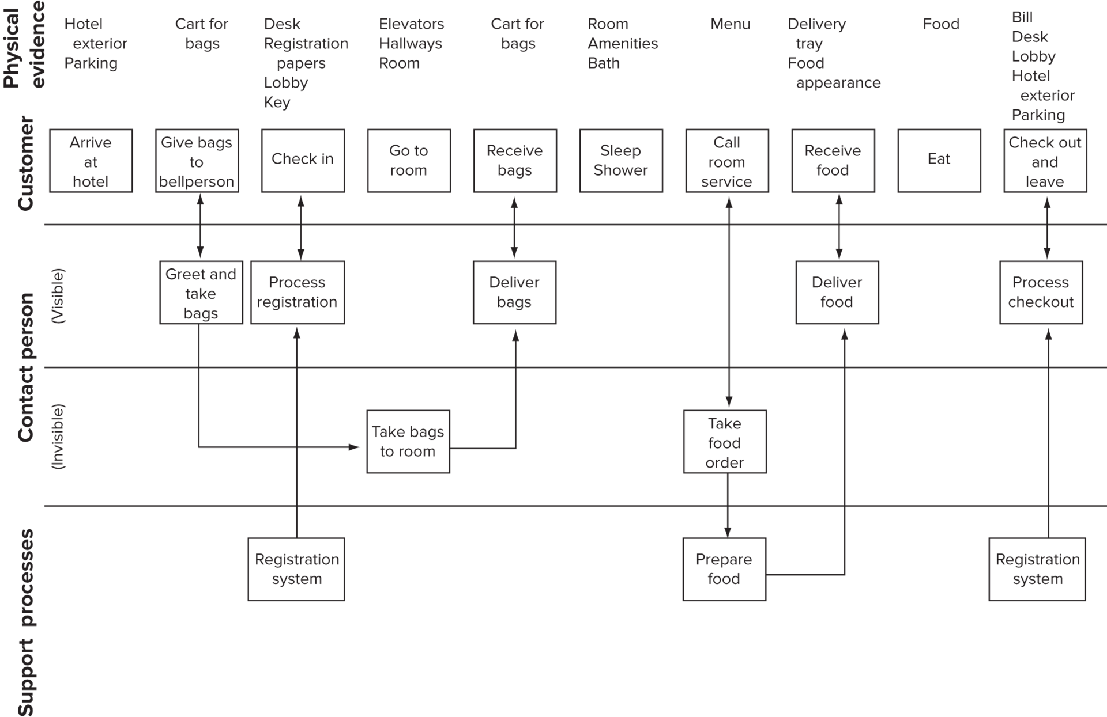
Blueprint for Overnight Hotel Stay Service

Slide 36
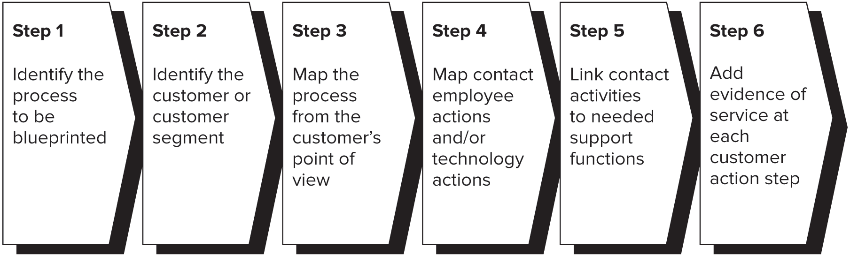
Building a Blueprint
Notes:
2: Different blueprints need to be made for different customer segments
3: Chart the choice and actions that the customer performs or experiences in purchasing, consuming, evaluating the service.
4: Draw lines of interaction and visibility, map process from frontline employee point of view – visible and invisible actions
5: Link internal processes – certain steps may turn out to be unnecessary and can be eliminated

